Slide 1
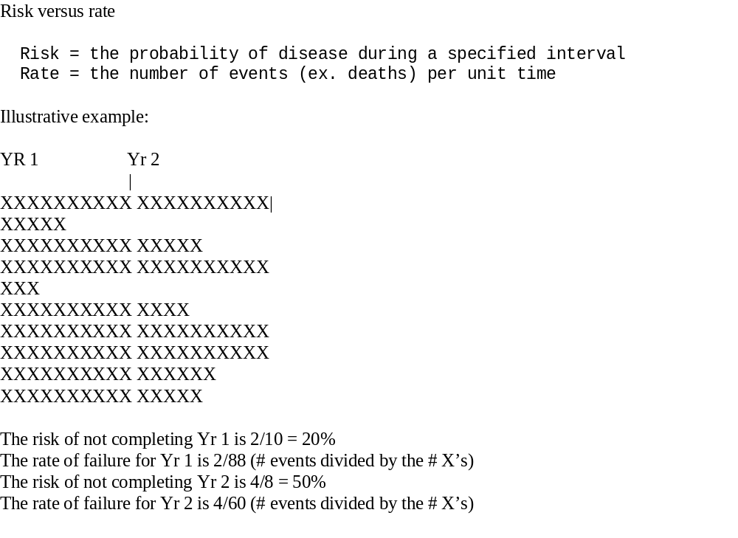

Slide 2
Survival analysis
Models relative rates
Uses time to a single event

Slide 3
Analyses with multiple events per person
One approach is to use a regression method called Poisson regression, or a related method called Negative Binomial regression

Slide 4
Poisson Regression
A method for analyzing outcomes that have positive integer values (1, 2, 3, and so on)
Results are valid for rare events (e.g., hospitalizations, unusual complications)

Slide 5
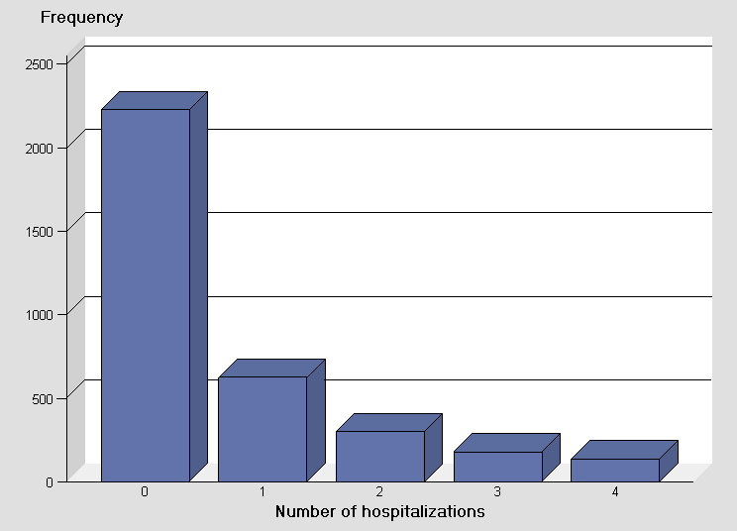
Distribution of count data (far from normal)

Slide 6
Treatment of Time
Poisson regression can model rare events when everyone is followed for the same length of time
Poisson regression can model rare events when people have different lengths of follow-up

Slide 7
OOOOOOOOOO
OOOOXOOXOO
OOOOOOOOOO
OOOOXOOOOO
OOOOOOOOOO
OOOOOOOOOO
OOOOOOOOOO
OOOOOOOOOO
OOOOOOOOOO
OXOOOXOOOO
Equal follow-up
Five events (X’s) per 100 intervals (Rate = 5/100)

Slide 8
OOOOOOOOOO
OOOOXOOXOO
OOOOO
OOOOXOOOOO
OOO
OOOOOOOOOO
OOOOOOOOOO
OOOOOOOOOO
OOOOOOOOOO OXOOOXOOOO
Unequal follow-up
Five events (X’s) per 88 intervals (Rate = 5/88)

Slide 9
Poisson Regression
Poisson regression is modeled on the log scale
Log (# of counts)
= B_{o} + β₁x₁ + β₂x₂ + … + β_{n}x_{n}
where B’s are the regression coefficients, and the x’s are the predictors.

Slide 10
Exponentiated regression coefficients give the relative rates per unit of time
Examples:
The regression coefficient for the number of hospitalizations comparing patients on treatment as compared to placebo is 0.634.
The relative rates of hospitalizations are e^{0.634} or 1.89

Slide 11
Another Example
Log(# complications)
= β_{o} + β₁ * Age
= -0.405 + 0.210 * Age
Increase in rate of complications per year of age equals e^{0.210} = 1.24

Slide 12
(Often unrealistic) assumption of Poisson Regression
Poisson Regression assumes that the mean equals the variance
Example: The mean number of complications equals the variance in complication rates (i.e., equals n*p*(1-p), where p is the probability of having a complication)

Slide 13
Overdispersion
If the variance is greater than the mean your data are said to be overdispersed.
Overdispersed data have standard errors and p-values that are too small.

Slide 14
Checking for overdisperson
Examine the mean and standard deviation for some categories of interest
Examine the ratio of the deviance to the degrees of freedom (it should be close to 1.0)

Slide 15
Correcting for Overdispersion
SAS has an adjustment called the Pearson adjustment that can give you the correct answers
The Pearson adjustment corrects the standard errors and gives you more accurate p-values

Slide 16
The negative binomial distribution
Always corrects for overdispersion
Handles counts that are not rare

Slide 17
Negative binomial regression
Log (# of events)
= B_{o} + β₁x₁ + β₂x₂ + … + β_{n}x_{n}. + σ * e, where e are the errors.
The term σ * e corrects for overdispersion

Slide 18
Treatment of Time
Negative binomial regression can model rare events when everyone is followed for the same length of time
Negative binomial regression can model rare events when people have different lengths of follow-up

Slide 19
Faulty teeth in children
Six schools assigned to six treatments
Control
Oral health education (educ)
School diet enriched with ricebran (enrich)
Rinse with mouthrinse (rinse)
Oral hygiene (hygiene)
All (given all four treatments)

Slide 20
Other variables
Gender
Male=1
Female=0
Ethnicity as 0/1 indicator variables
Brown
Black
White (as 0/1 indicator variables))

Slide 21
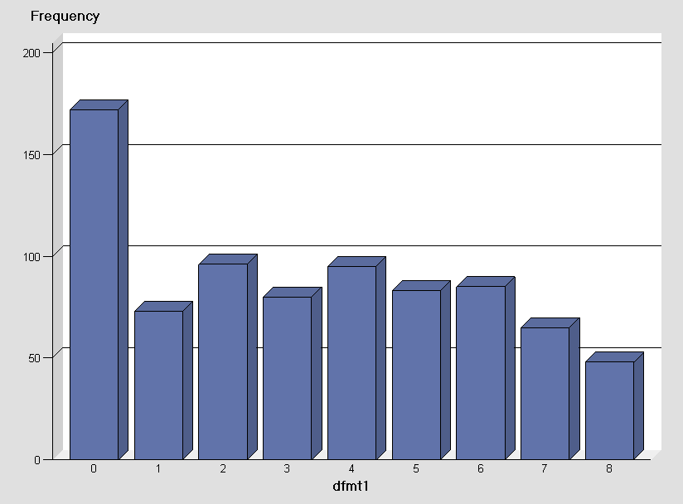

Slide 22
Open the dataset dffits
A study of 797 Brazilian children who participated in a dental health trial

Slide 23
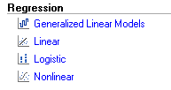
Select Generalized Linear Models from the Task List

Slide 24
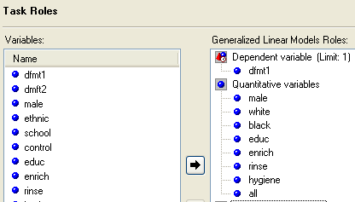
Choose dfmt (the number of decayed, missing or filled teeth) as the dependent variable and include the listed quantitative variables

Slide 25
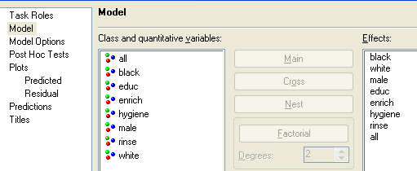
Select all of the quantitative variables as Effects

Slide 26
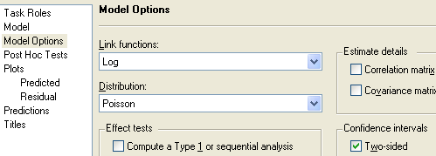
Select Log as the link function, Poisson as the distribution, and check Two-sided confidence intervals

Slide 27
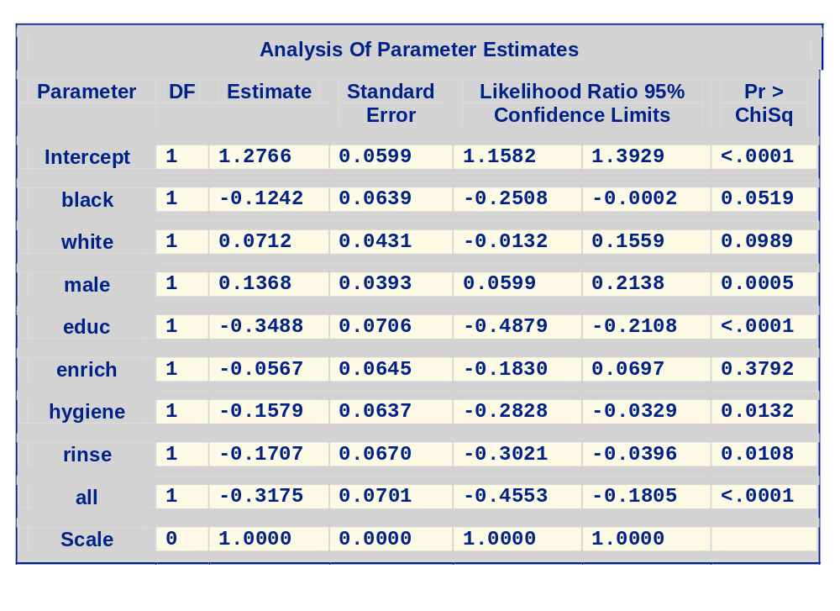
Results of Poisson Model

Slide 28
Based on the ratio of the deviance to the degrees of freedom of 2.48 the model appears overdispersed
Criteria For Assessing Goodness Of Fit
Criterion | DF | Value | Value/DF
Deviance | 788 | 1957.3059 | 2.4839

Slide 29
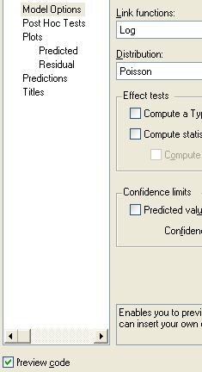
Reopen the icons and check Preview code from the Model Options

Slide 30
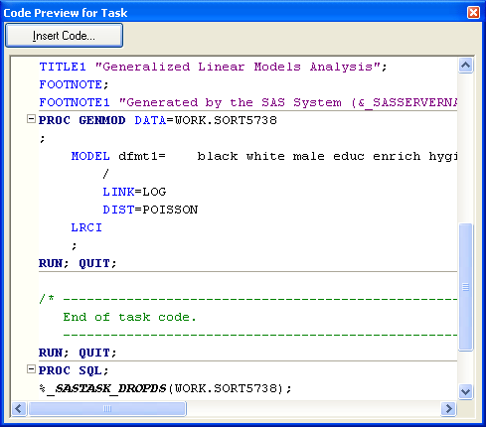
Scroll down to LRCI and then click Insert Code on the top

Slide 31
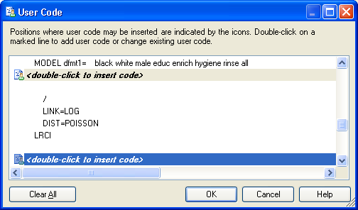
Scroll down to the following code and double click on <double-click to insert code>

Slide 32
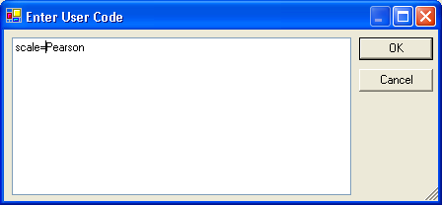
Type scale=Pearson on the box that appear and click ok to get back to the icons

Slide 33
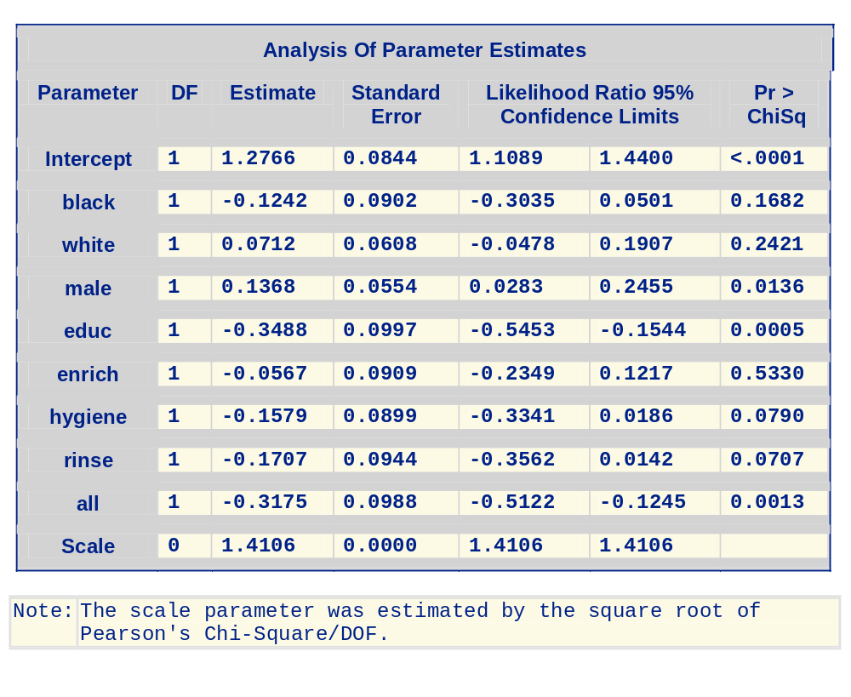
Results are corrected for overdisperson

Slide 34
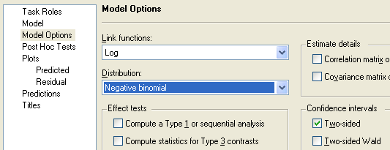
Starting from the beginning fit the same prediction model using the negative binomial distribution

Slide 35
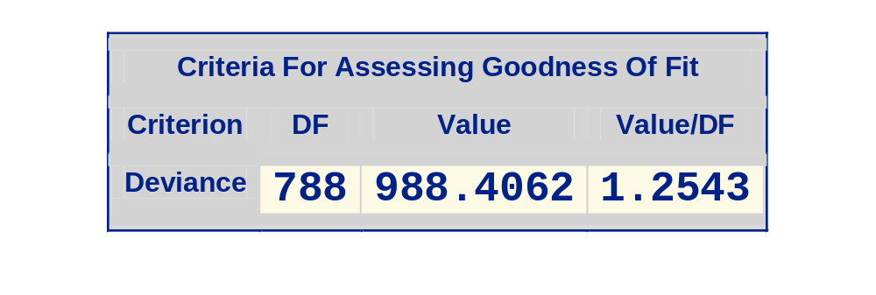
Note that the deviance to DF ratio is better

Slide 36
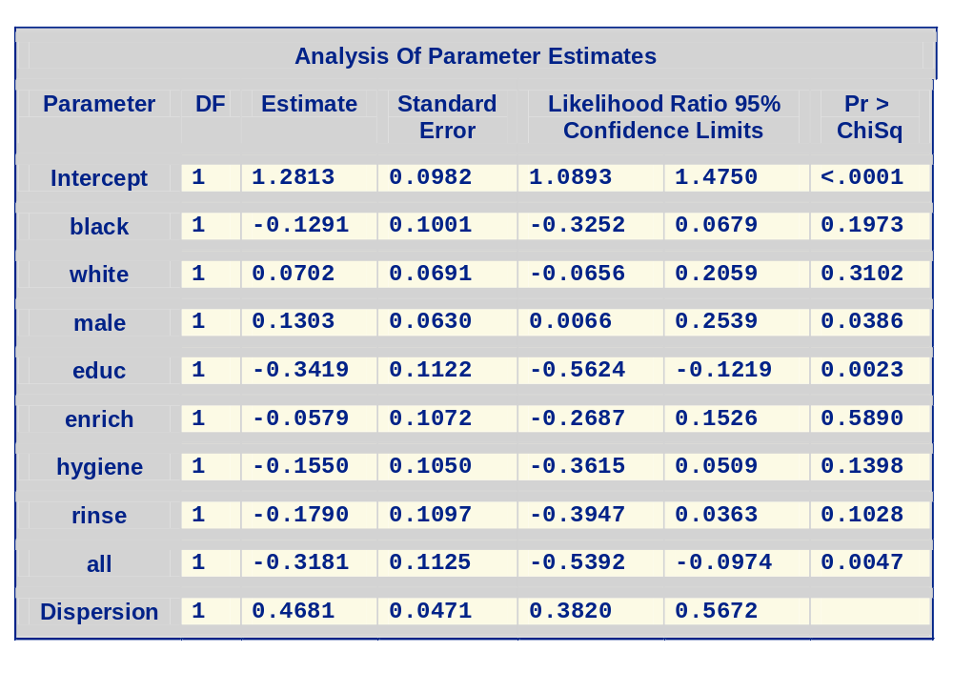
Results of the negative binomial regression

Slide 37
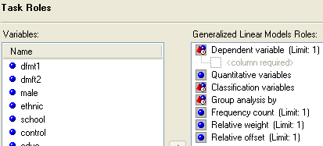
If the participants are followed for unequal lengths of time drag the variable giving the time under Relative Offset

